Slide 1
The Baskets Queue
Lakshmi Madhuri Yarava

Slide 2
History and Motivation:
The motivation is taken from the concurrency (threading , cas) and from the queues
Here in queues generally a single node will be pushed , but here it is speeded up to push multiple elements at a time using threading and cas
M. Hoffman, O. Shalev, and N. Shavit have written this algorithm with the motivation to speedup the queues in 2007 (date is not clearly mentioned)
Here the speeding up is done using the cas operation in Java as the main theme but there are no pointers in Java naturally so there is no much development and there is lack of availability of codes on this too.
So on motivation of threading and pointers in cpp my code is worked out without cas operation using only threading for the concurrency

Slide 3
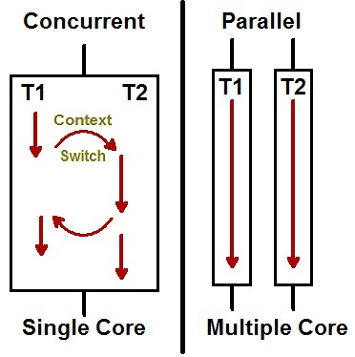
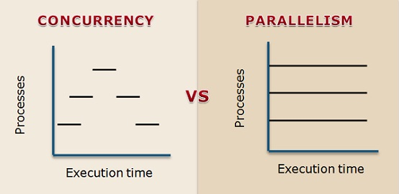
Introduction :
FIFO(First In First Out) Queues are one of those most widely used Concurrent Data Structures,but this doesn’t offers Parallelism(No two tasks can execute at same time)
Parallelism:-doing lot of things at once.FIFO is concurrent but not parallel means it processes more than one task at a time but no two tasks are executing at the same time
So,here comes “Baskets Queue” a new, highly concurrent lock-free linearizable dynamic memory FIFO queue , which offers Parallelism among Enqueue operations by creating “baskets” of nodes rather than ordered lists and allowing multiple enqueue operations at same time.

Slide 4
Cnt :
It allows parallelism in design of Concurrent shared queues.In Enqueue operation,it basically creates baskets of mixed-order items instead of the standard totally ordered list.
In our new “basket” approach, instead of the traditional ordered list of nodes, the queue consists of an ordered list of groups of nodes (baskets).
The order of nodes in each basket need not be specified, and in fact, it is easiest to maintain them in LIFO order.
So we can do many enqueue and dequeue operations parallelly Operations in different baskets can be executed parallelly.

Slide 5
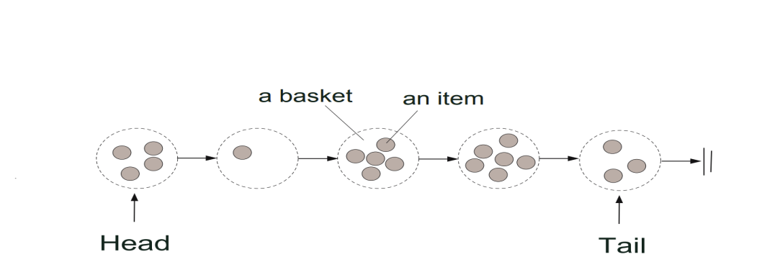
Approach :
Our new approach is having Numerous Baskets with one or more nodes listed with numbers.Our new Queue will be FIFO-ordered list of baskets
Order of nodes in Baskets in not defined.However when nodes in different baskets overlap,we consider FIFO-order of their respective baskets

Slide 6
Basic Rules of Baskets Queue:
For a basket having one or more nodes,baskets must fulfill these basic rules:-
Each basket has a time interval in which all its nodes’ enqueue operations overlap.
The baskets are ordered by the order of their respective time intervals.
For each basket, its nodes’ dequeue operations occur after its time interval.
The dequeue operations are performed according to the order of baskets.
Two properties define the FIFO order of nodes:
The order of nodes in a basket is not specified.
The order of nodes in different baskets is the FIFO-order of their respective baskets.
The basic idea behind these rules is that setting the linearization points of enqueue operations that share an interval according to the order of their respective dequeues, yields a linearizable FIFO-queue.

Slide 7
Functions :
Enqueue Operation:-Thread enqueue items by applying a Compare-and-swap (CAS) operation to queue’s tail pointer. Some threads may fail CAS operation , overlap in time,share the time interval of CAS. So all these threads which are failed will be inserted into same basket (The time usually we spent on backing-off before trying to link onto the new tail, can now be utilized to insert the failed operations into the basket, allowing enqueues to complete sooner).
To enqueue a node , a thread first tries to link the new node to the last node.If it
failed to do so, then another thread has already succeeded by inserting another one.

Slide 8
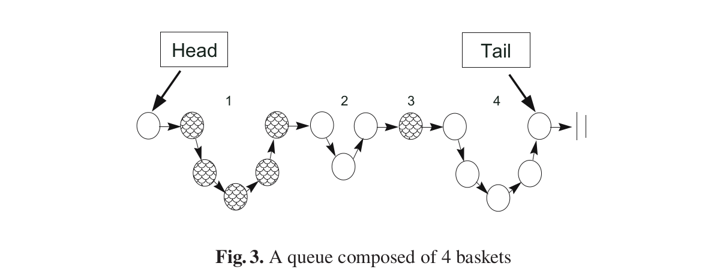
Notes:
Moreover, the failed operations don’t retry their link attempt on the new tail, lowering the overall contention on it.

Slide 9
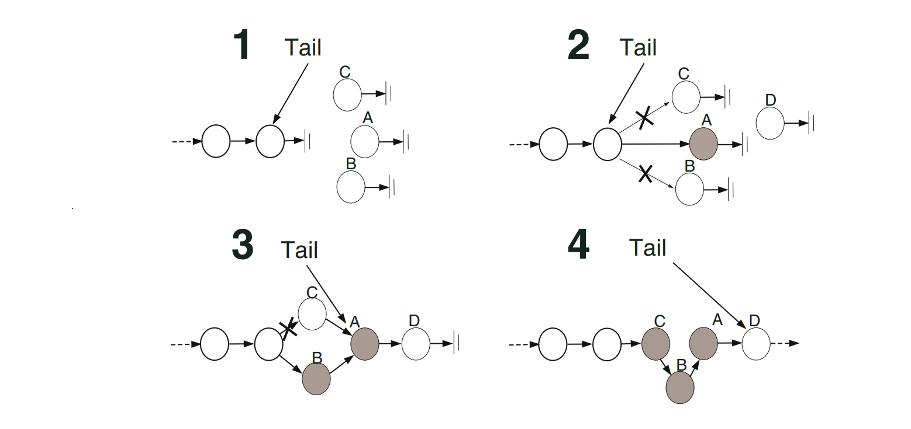
Example :

Slide 10
Explanation :
Here , we have three threads A,B,C . Each of them checks if tail’s next node is null so that they can insert a new node and tries to atomically change it to point to its new node’s address
Out of them,Thread A succeeded to enqueue it’s node whereas B,C threads are failed and hence they will try to get themselves inserted
Thread B succeeded to enqueue, meanwhile,at the same time thread D calls the enqueue operation, and finishes successfully to enqueue onto the tail.
Then Thread C got enqueued successfully.

Slide 11
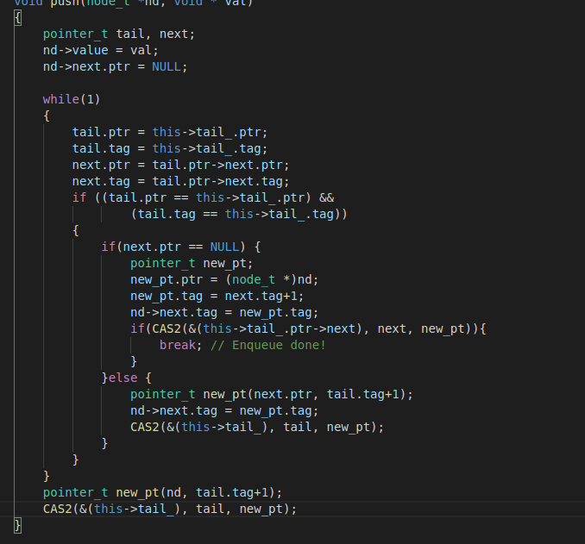
Pseudo code:
Notes:
To enqueue a node,
➔ first the thread reads current tail (E04)
➔ If Tail is the last node then it tries to atomically link the new node to the last node
(E09).
➔ We basically do CAS operation to compare and swap a new value in queue.So
here,we try to do CAS operation with Tails next pointer and a new node (E09)
➔ If the CAS operation succeeded the node was enqueued successfully, and the thread
tries to point the queue’s tail to the new node (E10), and then returns
➔ It re-reads the next pointer that points to the first node in the basket, and as long as
no node in the basket has been deleted (E13)
➔ Thus, the thread tries to insert the new node to the basket (E12-E18)
➔ If the tail did not point to the last node, the last node is searched (E20-E21), and the
queue’s tail is fixed

Slide 12
Functions :
Dequeue Operation:-To dequeue a node, a thread first reads the head of the queue to obtain the oldest basket. It may then dequeue any node in the oldest basket.

Slide 13
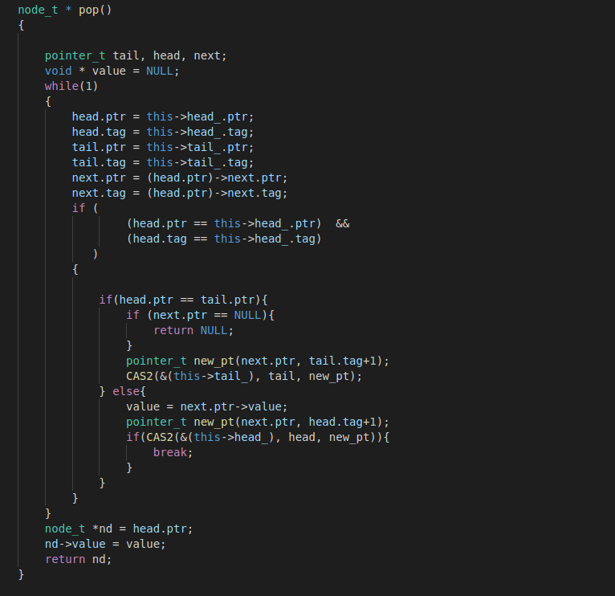
Pseudo code:

Slide 14
Process :
➔ a thread reads the current state of the queue like head and tail then it checks for its consistency .
➔ If the head and tail of the list point to the same node (, then either the list is empty or the tail lags. If not,last node is searched and the tail is updated .
➔ If the head and the tail point to different nodes, then the algorithm searches for the first unmarked node between the head and the tail .

Slide 15
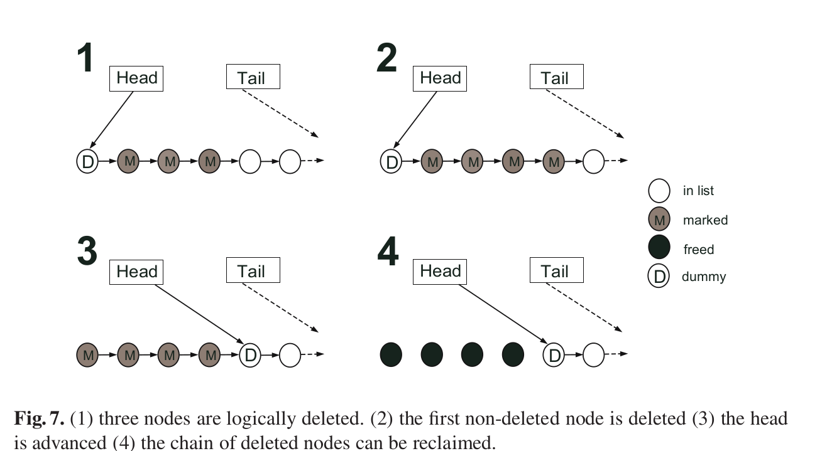
Performance

Slide 16
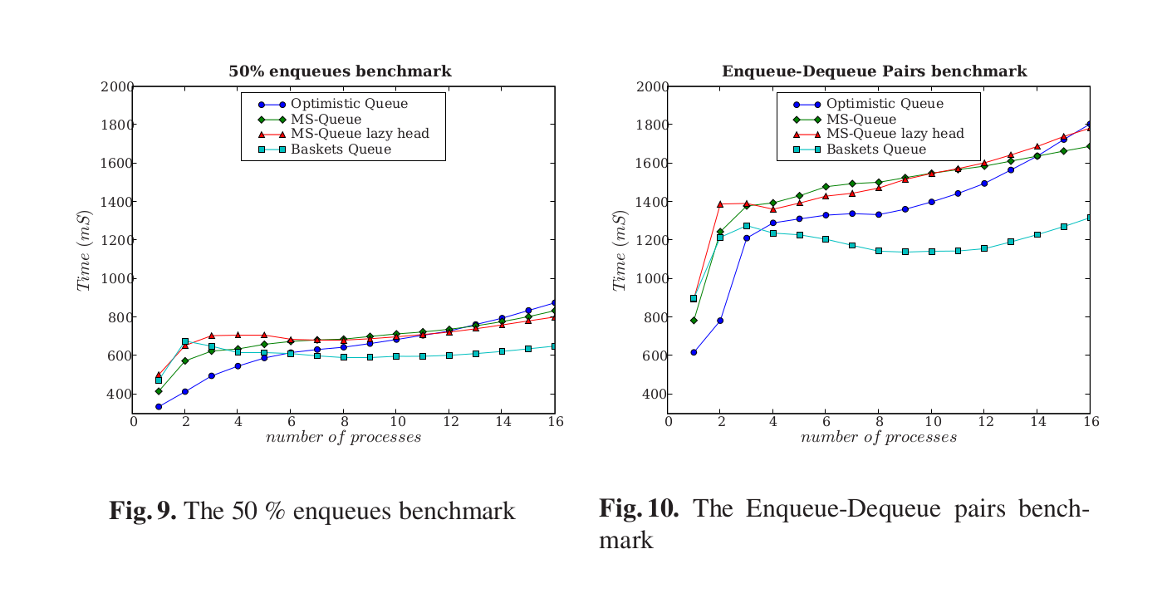
Performance :

Slide 17
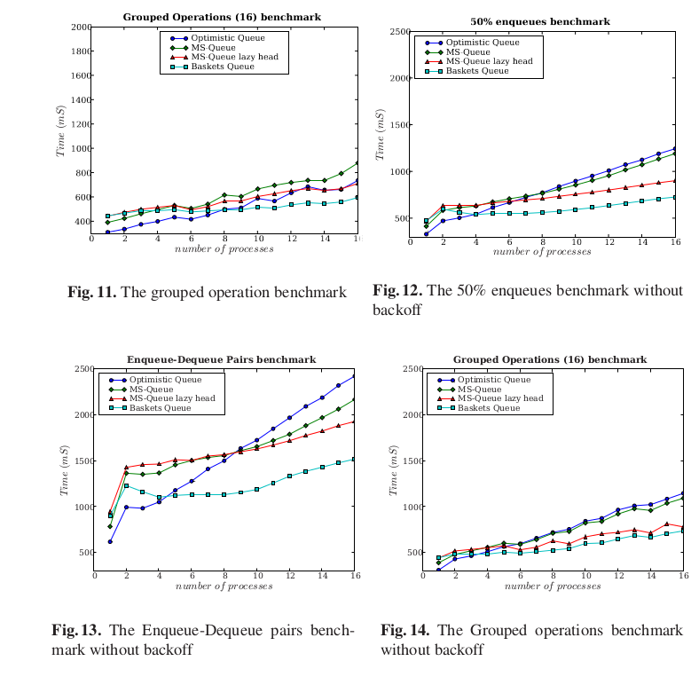

Slide 18
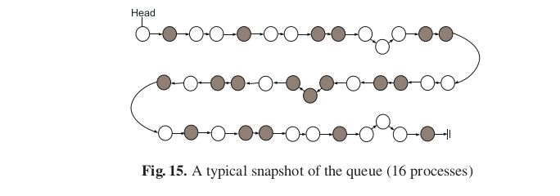
Typical Snapshot of Basket Queue :

Slide 19
Applications :
Wifi : when multiple people try to login to the same wifi or a same server then they can be given access to that particular node(wifi) in the form of queue , here it can be basket queue .

Slide 20
My way of Implementing:
I have created n threads where n represents number of nodes in the queue
Then i have called n threads simultaneously(concurrently) so that each thread pushes all the elements belonging to that node so that all the nodes are filled concurrently
Now after completion of making the queue the queries for enqueue and deque can be given
The queries are such as we can give some number of elements to be pushed into certain nodes ie. enqueue similarly multiple number of deques at a time concurrently using threading
rc=pthread_create(&threads[l],NULL, fun ,(void*)i) where the fun(i) is being called in the lth thread
pthread_detach(rc); here the thread rc will be detached from the thread
In this way threading is used here for concurrency it speeds up the programme at least to 5-6 times with bigger number of elements or nodes
Two codes are implemented to see the difference in time and noted down in the report
The times are calculated using high_resolution_clock::time_point t1 = high_resolution_clock::now()
The test cases are randomly generated from a python just to check the times of running
Results are listed

Slide 21
Serial no | No. of nodes | Avg no of elements | Delay | Non threading time | Threading time | Diff
1. | 100 | 300 | 0.01 | 8.55453 | 2.77835 | ~(5.8)
2. | 500 | 300 | 0.01 | 29.2752 | 9.31419 | ~(20)
3. | 50 | 3000 | 0.01 | 37.5207 | 1.96919 | ~(36)
4. | 100 | 500 | 0.01 | 12.5765 | 3.83965 | ~(9)
5. | 300 | 500 | 0.05 | 31.0257 | 5.73413 | ~(22.5)
6. | 300 | 4000 | 0.05 | 334.605 | 12.1008 | ~(320)
7. | 30 | 40 | 0.05 | 0.384233 | 0.931467 | ~(-0.6)
8. | 30 | 40 | 0.001 | 0.384233 | 0.681467 | ~(-0.28)
9. | 200 | 12 | 0.001 | 0.915582 | 3.70447 | ~(-3)
10. | 2000 | 125 | 0.05 | 45.7845 | 26.4583 | ~(20)
RESUL
TS

Slide 22
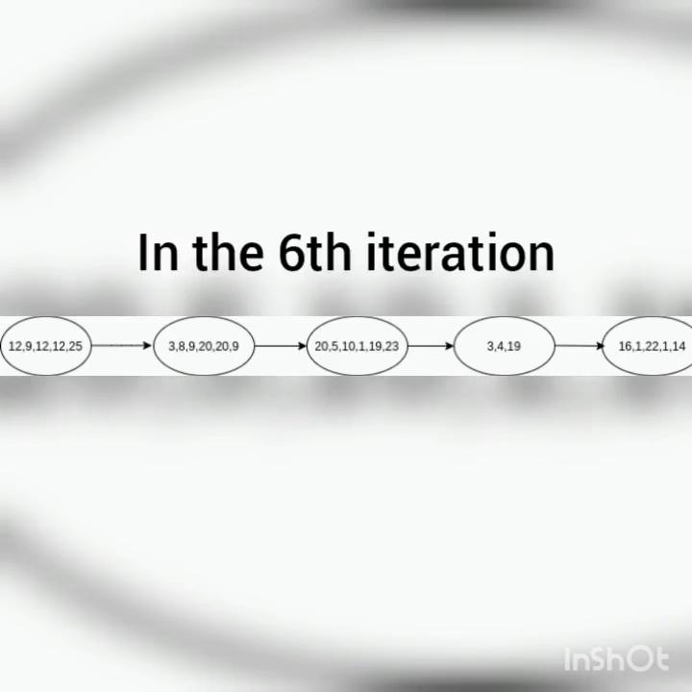
An example of 5 nodes is shown
12,9,12,12,9
3,8,9,20,20,9
20,5,10,1,19,23,9,14,9
3,4,19
16,1,22,1,14
The pushing is concurrent so in each iteration 1 element is pushed into each node in multiple threads as depicted
https://drive.google.com/file/d/11rGEYbHl3FsWJW7NmrlU-O8ZSupO3xoz/view?usp=sharing

Slide 23
Reference Paper :
The Baskets Queue, Moshe Hoffman, Ori Shalev, and Nir Shavit
Link :- https://people.csail.mit.edu/shanir/publications/Baskets%20Queue.pdf

Slide 24


